Slide 1
Introduction to Java for Business BU350.700.51 Spring I 2025
More About Classes & Method Overloading

Slide 2
Method Overloading
Method Overloading is a common technique in Java programming as well as object-oriented programming in general
Method overloading is one way of achieving a concept called polymorphism
Method overloading is implemented by defining multiple methods that have the same name but have differences in the type and/or number of method arguments…i.e., they have different signatures
Method overloading can be implemented in static methods and instance methods

Slide 3
Example of Method Overloading
// Program to illustrate method overloading
public class MethodOverloadingDemo1
{
public static void main( String [] args )
{
System.out.println();
System.out.println( "The maximum of 2 and 3 is " + max( 2, 3 ) );
System.out.println( "The maximum of 6.0 and 5.9 is " + max( 6.0, 5.9 ) );
System.out.println( "The maximum of 4 and 7.5 is " + max( 4, 7.5 ) );
}
public static int max( int a, int b )
{
if( a > b )
return a;
else
return b;
}
public static double max( double a, double b )
{
if ( a > b )
return a;
else
return b;
}
}

Slide 4
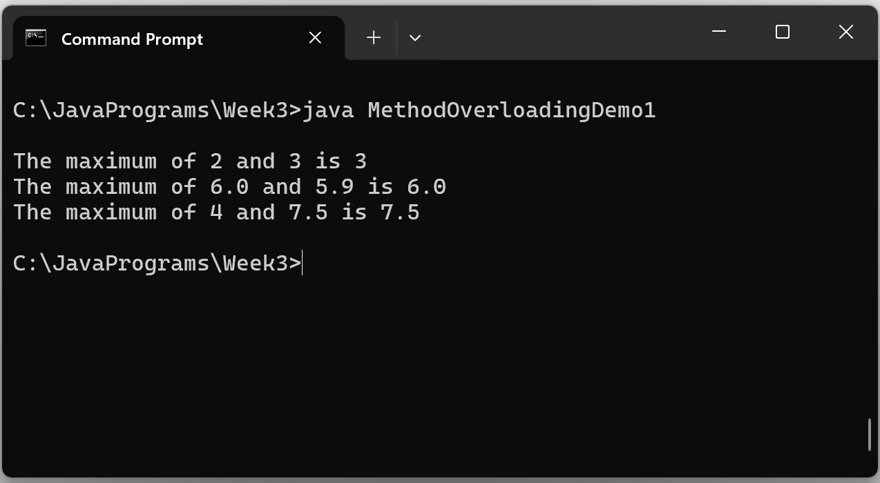
Sample Program Output

Slide 5
Overloading Constructors
public class MyClass
{
private int x;
private int y;
public MyClass( int v1, int v2 )
{
x = v1; y = v2;
}
public MyClass() { x = 0; y = 0; }
public int getX() { return x; }
public int getY() { return y; }
}
// A program to illustrate a parameterized constructor
public class MultipleConstructorDemo
{
public static void main( String [] args )
{
MyClass aClass = new MyClass( 10, 20 );
MyClass anotherClass = new MyClass();
System.out.println();
System.out.println( "x is " + aClass.getX() );
System.out.println( "y is " + aClass.getY() );
}
}

Slide 6
Be Careful Not to Create Ambiguity
The method call in main() creates an ambiguity…and the program will not compile
public class MethodOverloadingDemo2
{
public static void main( String [] args )
{
System.out.println();
System.out.println( "The maximum of 2 and 3 is " + max( 2, 3 ) );
}
public static int max( int a, double b )
{
if( a > b )
return a;
else
return b;
}
public static double max( double a, int b )
{
if ( a > b )
return a;
else
return b;
}
}

Slide 7
Passing Objects to Methods
public class MyClass
{
private int x = 0;
private int y = 0;
public MyClass( int v1, int v2 )
{
x = v1; y = v2;
}
public int getX() { return x; }
public int getY() { return y; }
public void setData( int v1, int v2 )
{
x = v1;
y = v2;
}
}

Slide 8
Passing Objects to Methods
// Program to illustrate passing objects to methods
public class PassingObjectsDemo1
{
public static void main( String [] args )
{
MyClass anObject = new MyClass( 10, 20 );
display( anObject );
manipulateObject( anObject );
display( anObject );
}
public static void manipulateObject( MyClass obj )
{
obj.setData( 99, 99 );
}
public static void display( MyClass obj )
{
System.out.println();
System.out.println( "x is " + obj.getX() );
System.out.println( "y is " + obj.getY() );
}
}

Slide 9
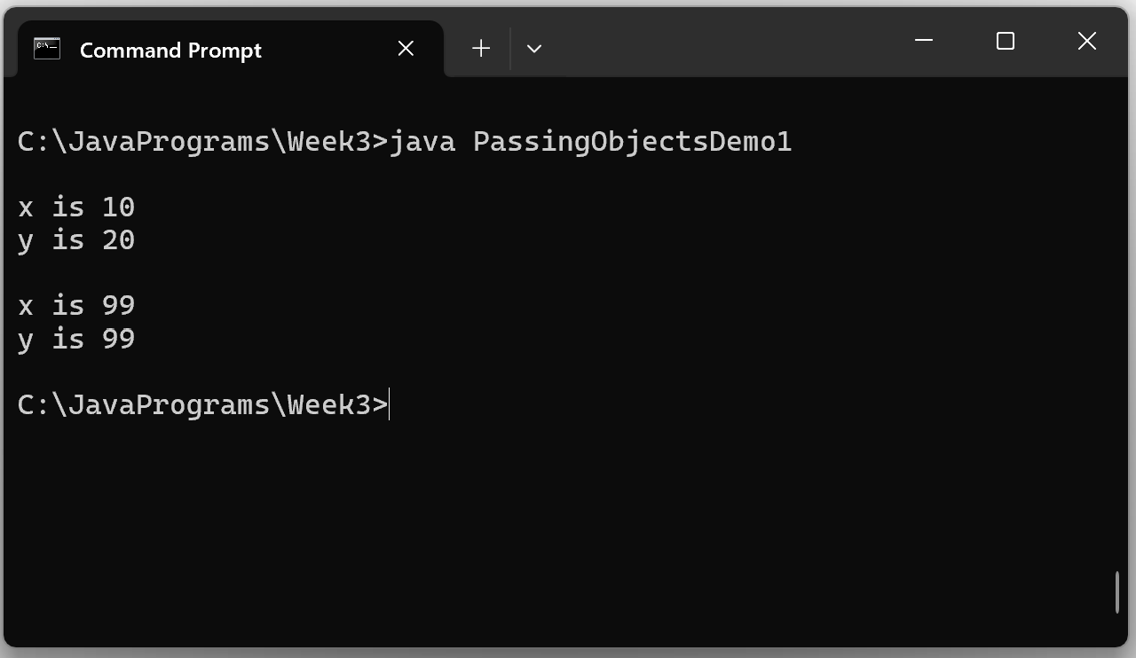
Passing Objects to Methods

Slide 10
Returning Objects From Methods
public class Book
{
private String author;
private String title;
public Book( String a, String t )
{
author = a;
title = t;
}
public String getAuthor() { return author; }
public String getTitle() { return title; }
}
public class ReturnObjectDemo1
{
public static void main( String [] args )
{
Book myBook = createBook( "Mario Puzo", "The Godfather" );
System.out.println();
System.out.println( "Author = " + myBook.getAuthor() );
System.out.println( "Title = " + myBook.getTitle() );
}
public static Book createBook( String a, String t )
{
Book b = new Book( a, t );
return b;
}
}

Slide 11
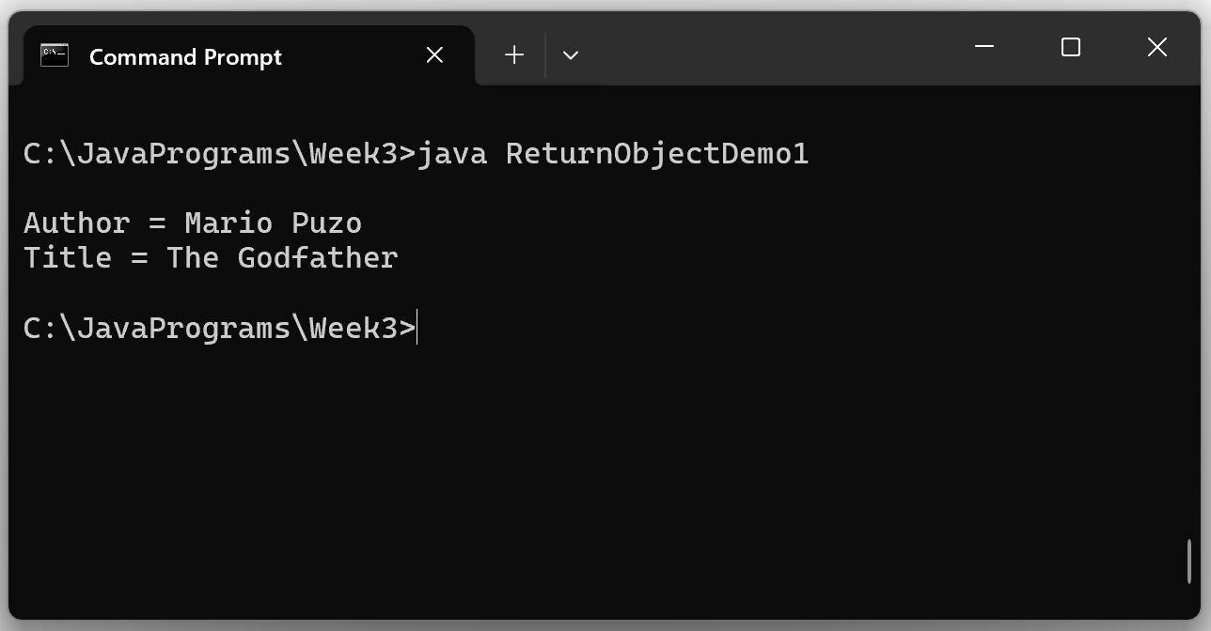
Returning Objects From Methods

Slide 12
Composite Classes
Composite Classes Contain Other Class Objects as Members
// Class to model a simple date
public class Date
{
private int month;
private int day;
private int year;
public Date( int m, int d, int y )
{
month = m;
day = d;
year = y;
}
public String getDate()
{
return month + "/" + day + "/" + year;
}
}
public class Person
{
private String name;
private Date birthDate;
public Person( String nm, Date bd )
{
name = nm;
birthDate = bd;
}
public String getName() { return name; }
public String getBirthDate()
{ return birthDate.getDate();
}
}

Slide 13
Composite Classes
Composite Classes Contain Other Class Objects as Members
// Program to illustrate a composite class
public class CompositeClassDemo1
{
public static void main( String [] args )
{
Date bDate = new Date( 10, 10, 2015 ); // Create a birthdate
Person aPerson = new Person( "Tony Baggadonuts", bDate ); // Create a Person object
System.out.println();
System.out.println( "Name: " + aPerson.getName() );
System.out.println( "Birth Date: " + aPerson.getBirthDate() );
}
}
Note that we had to create a Date object to pass to the Person constructor

Slide 14
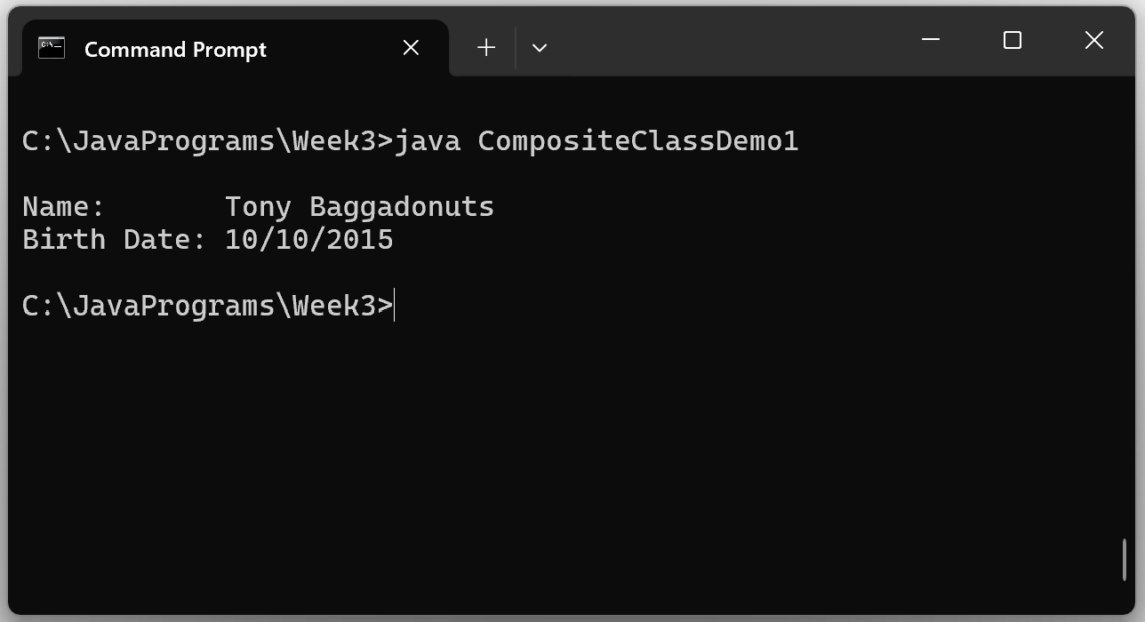
Composite Class Demo
Program Output

